Slide 1
New Delight Engineering BV
Company presentation

Slide 2
Overview
Who we are
Activities
Projects

Slide 3
Engineering is a Delight
We love to create things
explore possibilities
using components and tools at hand
But always come to a workable solution
in terms of technical feasibility
timing
and budget

Slide 4
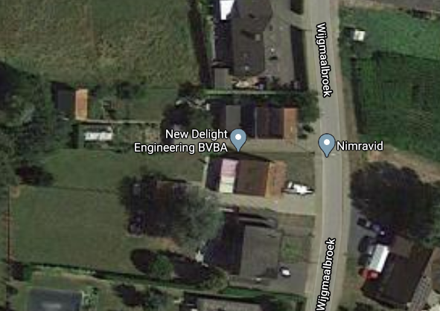
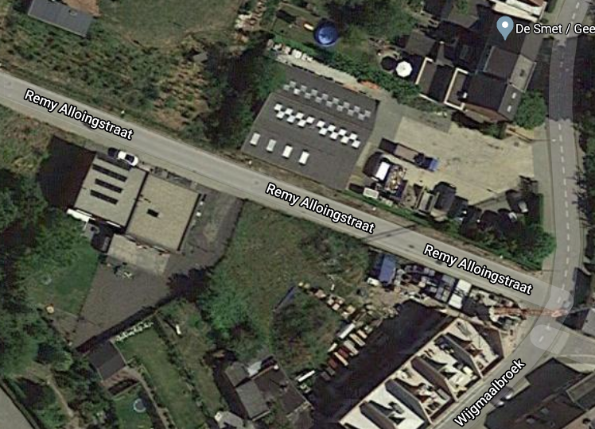
Who we are
Founded in May 2010 by Dirk Uwaerts, Bert Uwaerts joined in September 2013.
Financial:
Capital: € 81 600
Balance : € 328 612.25
Address: Wijgmaalbroek 85 3012 Wijgmaal.
New office (under construction) : Remy Alloingstraat 13 3018 Wijgmaal

Slide 5
Activities
Consulting:
Dirk:
Project management and Systems & Test team lead for image sensor-related projects since 1996.
IMEC, Fillfactory, Cypress Semiconductor, Xenics, Caeleste
Bert:
Electronic design: Schematics, Layout, Follow up on production, Debug, ..
Xenics, Caeleste
Fixed price projects:
Mainly in the field of image sensors
Full development via our eco-system: partners for digital design, software development and mechanical design.
Consystemsea BV
Alinga BV
TBVL BV
Examples:
Illuspad: High-speed readout for Single-Photon Avalanche Diode (SPAD) array
SmartFiber: Wireless readout of IR line sensor for measurement of strain via Fiber Bragg Gratings (FBG)
Luxlumen: Control of LED array on ladies’ dress
CEFE: Implementation of ROIC array for detection of neural signals
EMROS: Readout electronics for 10 line-scan detectors for spectral analysis of metals.

Slide 6
Typical project flow
Discussion document
Collect all requirements
Iterated several times
Basis for a project proposal
Pre-design
Iterate requirements
System architecture: hardware, firmware, software
List of main components
Compliance statement
Detailed design
Hardware schematics and layout
Detailed hardware design review, checklist
Firmware coding and simulations
Software coding and dry-runs
Construction
Mainly hardware: PCB fabrication and assembly
Testing and qualification
First operation and debug: hardware, firmware and software combined
Formal characterization against every requirement
Ramp up to production (optional)
Production (optional)

